Slide 1
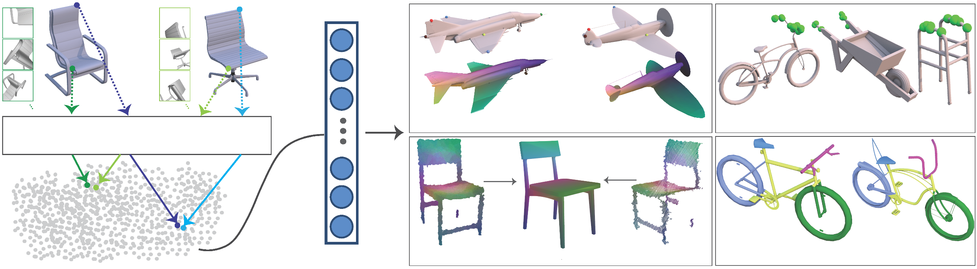
Learning Local Shape Descriptors from Part Correspondences with Multi-view Convolutional Networks
LMVCNN network
Keypoint matching
Affordance prediction
Scan-to-shape matching
Segmentation
Haibin Huang¹ Evangelos Kalogerakis¹ Siddhartha Chaudhuri^{2,3}
Duygu Ceylan³ Vladimir G. Kim³ Ersin Yumer³
¹University of Massachusetts Amherst ²IIT Bombay ³Adobe Research
Notes:
Hi I am Evangelos Kalogerakis and will present this paper on behalf of my co-authors. Our paper proposes a deep architecture for learning local shape descriptors.

Slide 2
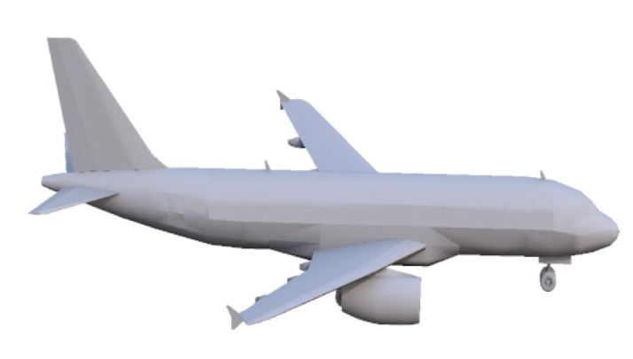
Goal: learn local shape descriptors
Notes:
Given an input 3D shape,

Slide 3
Goal: learn local shape descriptors
Notes:
and any point on it, such as the red point you see here

Slide 4
Goal: learn local shape descriptors
Multi-view
Convnet
(LMVCNN)
Local shape
descriptor
Notes:
, we designed a deep network, called Local Multi-view CNN, that produces a compact descriptor encoding the local geometry, context, and underlying semantics for that point.

Slide 5
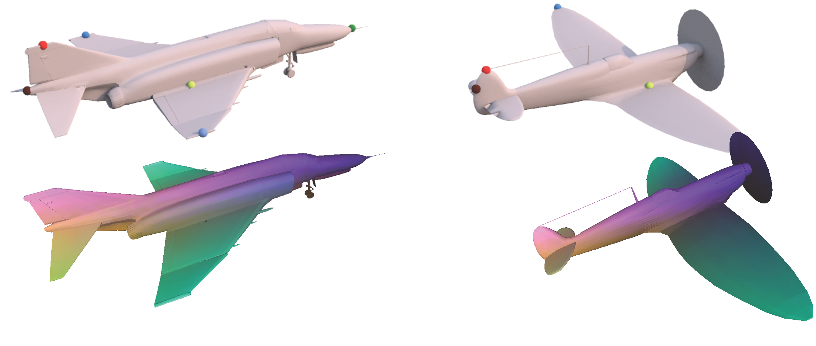
Why local shape descriptors? Keypoint detection/correspondences
(similar colors correspond to points with similar descriptors)
Notes:
Why do we need such point-based descriptors? They have many applications in graphics. By embedding geometrically and semantically similar points close to one another in descriptor space, we can find correspondences between 3D shapes through nearest neighbor queries in descriptor space, which is in turn useful for applications, such as alignment and texture transfer.

Slide 6
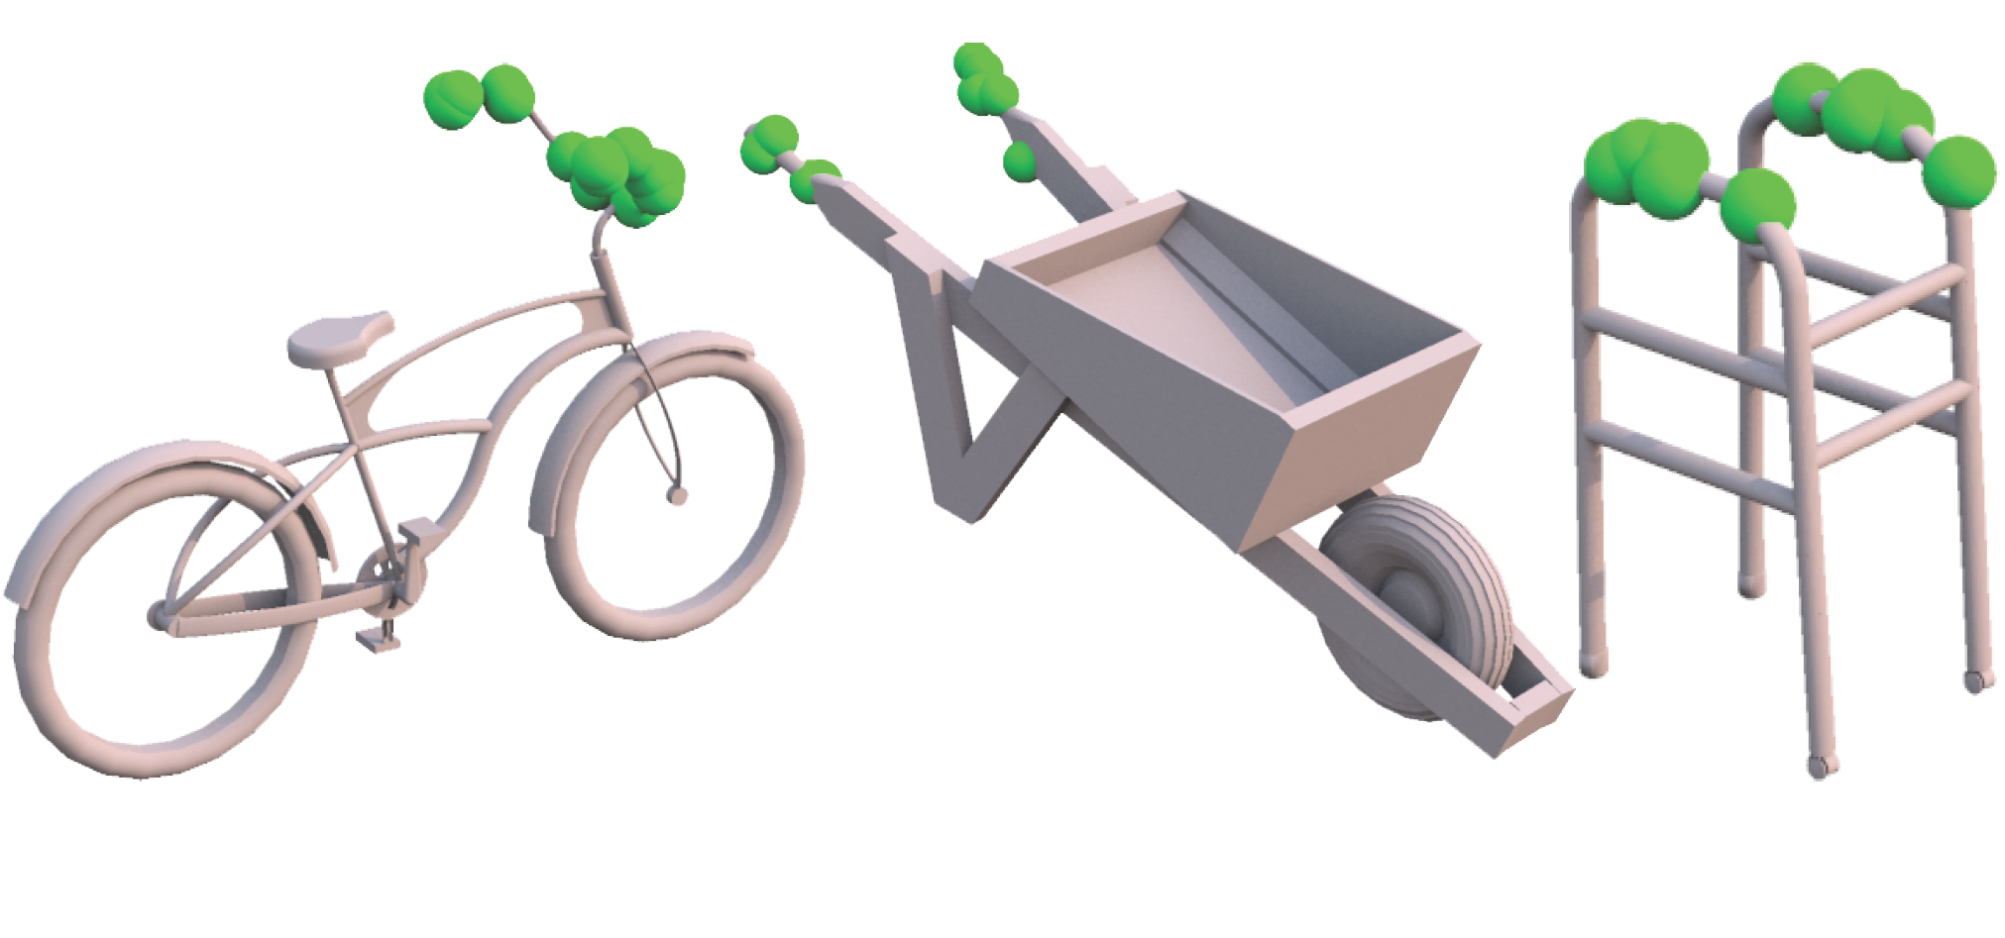
Why local shape descriptors? Affordance prediction
Where do humans place their palms
when they interact with these objects?
Notes:
Such point-based descriptors are also useful for predicting complex functions on shapes, such as affordance regions on 3D shapes. For example, here points highlighted with green color belong to regions where humans tend to place their palms when they interact with these objects.

Slide 7
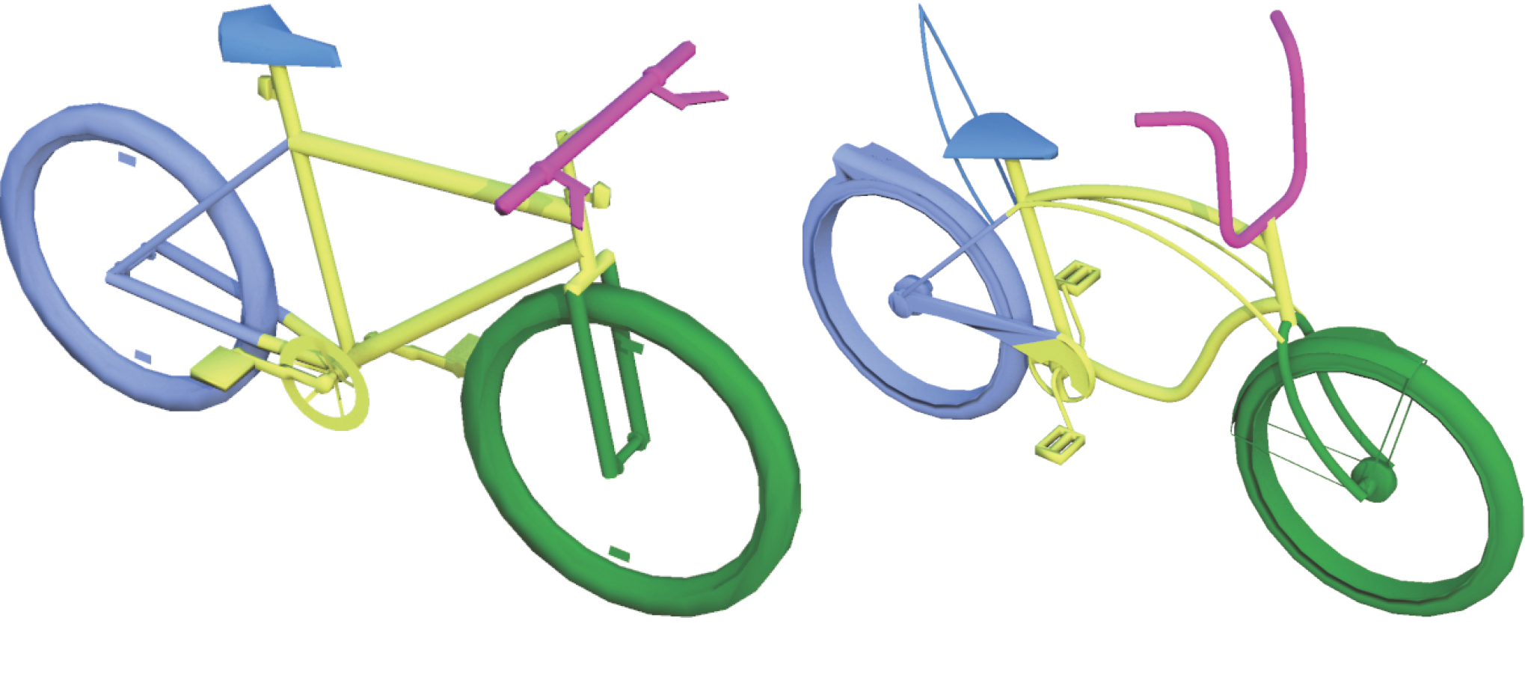
Why local shape descriptors? Shape segmentation & labeling
Classify points into labeled parts based on their descriptor
Notes:
Finally point-based descriptors are generally useful for shape analysis. For example, based on the extracted point descriptors, we can use a classifier that predicts part labels for the input shapes.

Slide 8
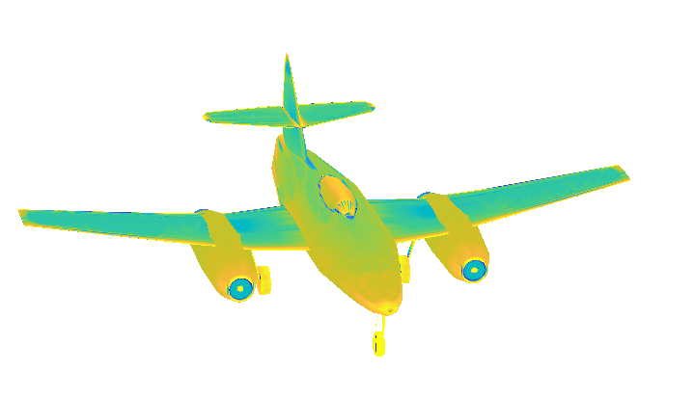
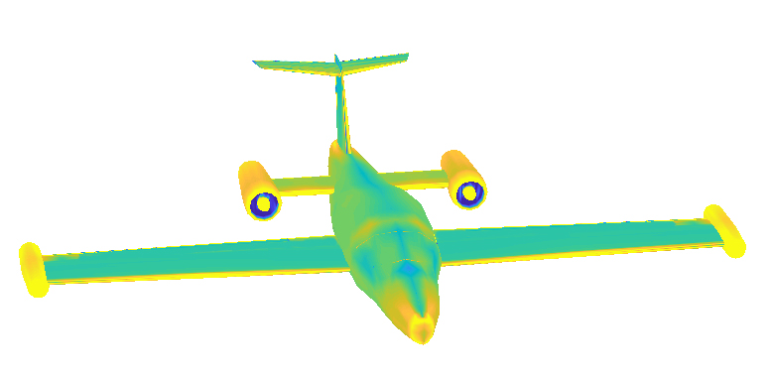
Challenges
Low-level geometric cues not informative enough to yield semantic-aware descriptors
e.g., mean curvature
Notes:
Developing such semantic- and functionality- aware descriptors is not easy. Simple geometric cues are not discriminative enough for high-level tasks – for example, here I visualize curvature, as a local descriptor, for two airplanes - many functionally different points and regions on the shape tend to have very similar curvature values.

Slide 9
Challenges
Low-level geometric cues not informative enough to yield semantic-aware descriptors
?
e.g., mean curvature
Notes:
In fact given a query region, like the engine, on the left, you may recover an irrelevant region on the other airplane, while a human would easily map engines to engines.

Slide 10
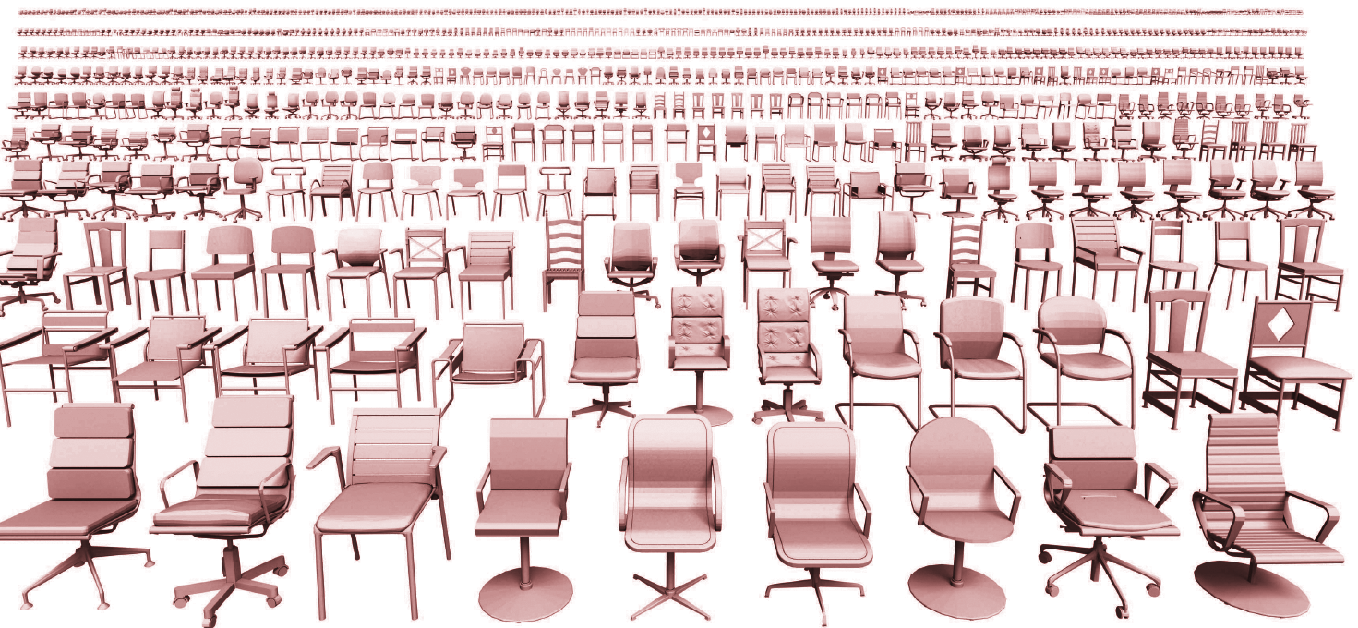
Challenges
Low-level geometric cues not informative enough to yield semantic-aware descriptors
Large structural & geometric variability across objects, mainly man-made objects
Models from Dosch Design
Notes:
In addition, we need descriptors that can reveal corresponding points across shapes, even if these shapes significantly vary both structurally and geometrically. Such structural and geometric variability is common in man-made shapes. Even if you consider a restricted domain, such as chairs, it is extremely hard to use hand-crafted, low-level geometric descriptors and rules to detect corresponding points given all this variability.

Slide 11
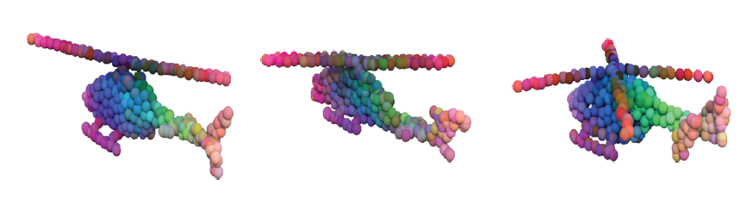
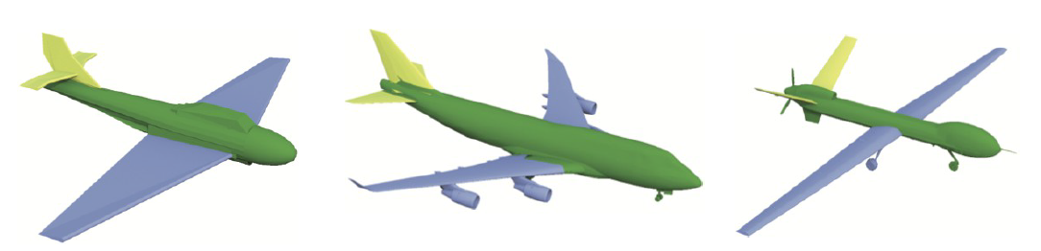
Challenges
Low-level geometric cues not informative enough to yield semantic-aware descriptors
Large structural & geometric variability across objects, mainly man-made objects
Generalize to novel object categories not seen during training
e.g., train on airplanes test descriptors on helicopters
Notes:
To avoid hand-engineering descriptors, one common approach nowadays is to resort to machine learning, and mainly deep learning. However, a particular challenge in machine learning is generalization to different classes of objects. For example, if one trains a descriptor learning approach on shapes of one class, such as airplanes, can it generalize to other classes of shapes without gathering training data all over again for these other classes? This is currently a big challenge in machine learning in general.

Slide 12
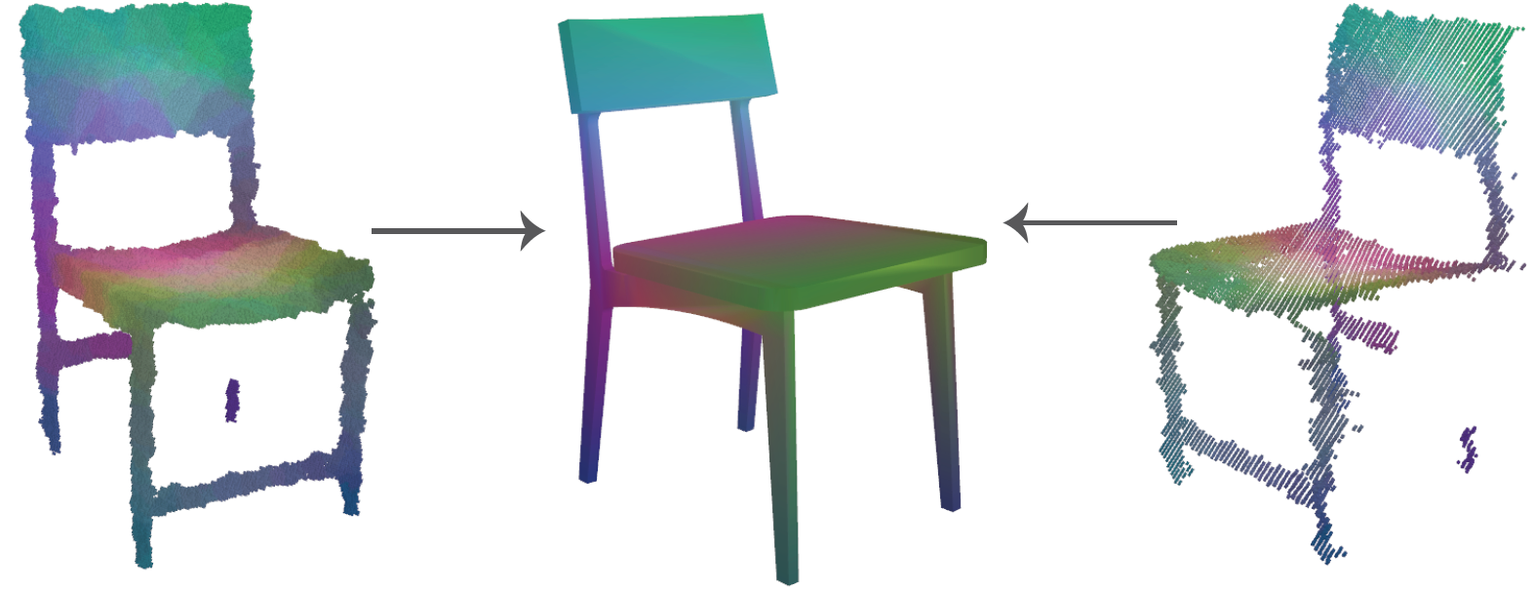
Challenges
Low-level geometric cues not informative enough to yield semantic-aware descriptors
Large structural & geometric variability across objects, mainly man-made objects
Generalize to novel object categories not seen during training
Robustness to noise and missing data
Noisy scan 3D model Partial Scan
Notes:
Finally, a desired property for local descriptors is robustness. Descriptors of points on object scans should be minimally affected by noise and missing data.

Slide 13
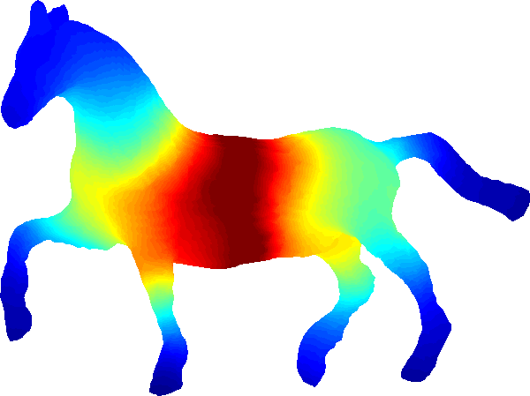
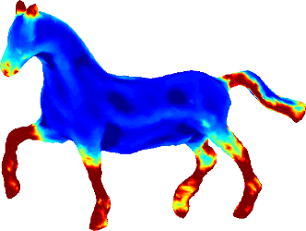
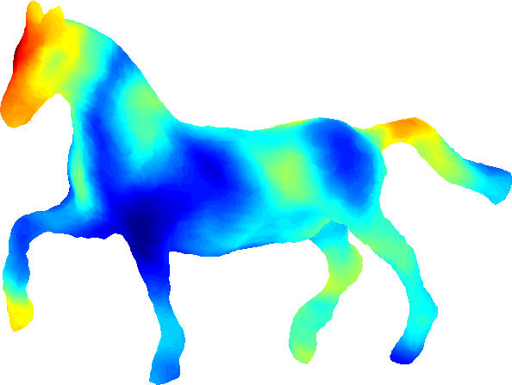
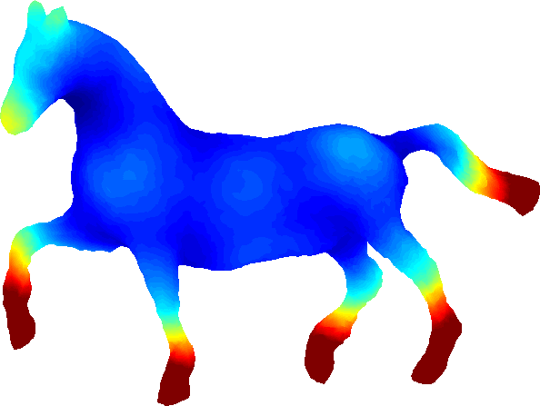
Related work
Hand-tuned geometric descriptors see Xu et al. EG STAR ‘16
PCA
curvature
shape contexts
intrinsic
Notes:
In the past, a common approach was to hand-craft geometric descriptors based on low-level geometic cues, such as PCA, intrinsic surface properties and so on. As I said earlier, these descriptors are not powerful enough.

Slide 14
Related work
Hand-tuned geometric descriptors see Xu et al. EG STAR ‘16
Approaches (concurrent / after our submission):
Volumetric / octree-based methods: Maturana et al. ‘15, Zeng et al. ‘17 (3DMatch), Riegler et al. ‘17 (OctNet), Wang et al. ‘17 (O-CNN), Klokov et al. ‘17 (kd-net) …
Point-based networks: Qi et al. ‘17 (PointNet / PointNet++), Hua et al. ’18 …
Graph-based / spectral networks: Yi et al. ‘17 (SyncSpecCNN), Bronstein et al. ’17 …
Surface embedding networks: Maron et al. ’17, Groueix et al. ’18 …
PCA
curvature
shape contexts
geodesic dist.
Notes:
Our work is more related to recent efforts on deep networks for learning local or global shape descriptors. Our work was submitted early in 2017, and concurrently to our approach or even afterwards, a larger number of deep learning approaches capable of producing shape descriptors have appeared, including networks operating on voxels, octrees, point sets, graphs, and surface embeddings.

Slide 15
Related work
Hand-tuned geometric descriptors see Xu et al. EG STAR ‘16
Approaches (concurrent / after our submission):
Volumetric / octree-based methods: Maturana et al. ‘15, Zeng et al. ‘17 (3DMatch), Riegler et al. ‘17 (OctNet), Wang et al. ‘17 (O-CNN), Klokov et al. ‘17 (kd-net) …
Point-based networks: Qi et al. ‘17 (PointNet / PointNet++), Hua et al. ’18 …
Graph-based / spectral networks: Yi et al. ‘17 (SyncSpecCNN), Bronstein et al. ’17 …
Surface embedding networks: Maron et al. ’17, Groueix et al. ’18 …
PCA
curvature
shape contexts
geodesic dist.
Our method: Multi-view network
Notes:
In contrast, our method belongs to the realm of view-based networks since a large part of our proposed architecture is dedicated to processing rendered views of local surface neighborhoods.

Slide 16
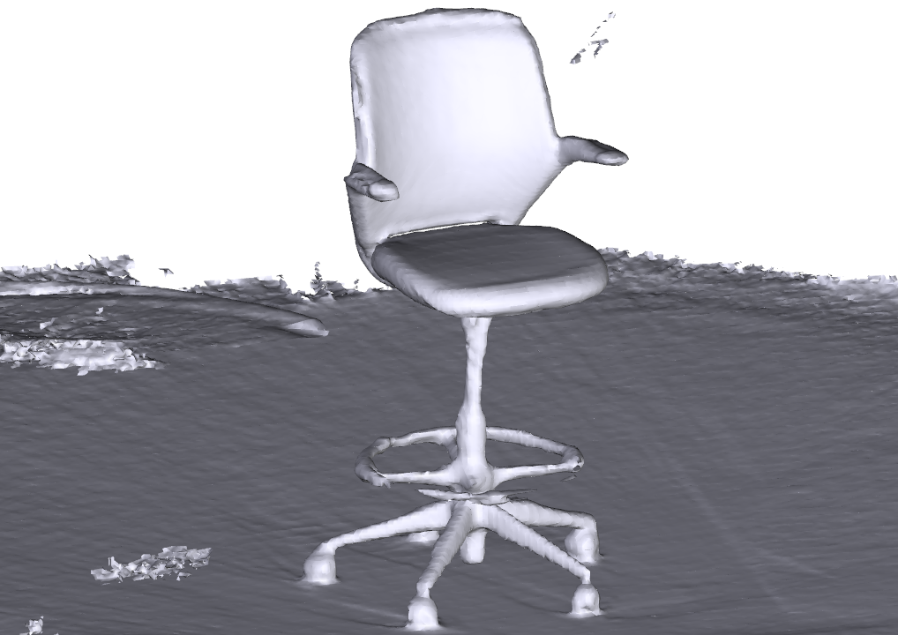
Key Observations
3D scans capture the surface.
+ noise, missing regions etc
Notes:
The choice of our view-based architecture was motivated by a few key observations. First, 3D models are often designed for viewing and their interior is empty. Similarly, 3D scans capture only surface, which further motivates us to focus the CNN representation power on the surface rather than the shape interior.

Slide 17
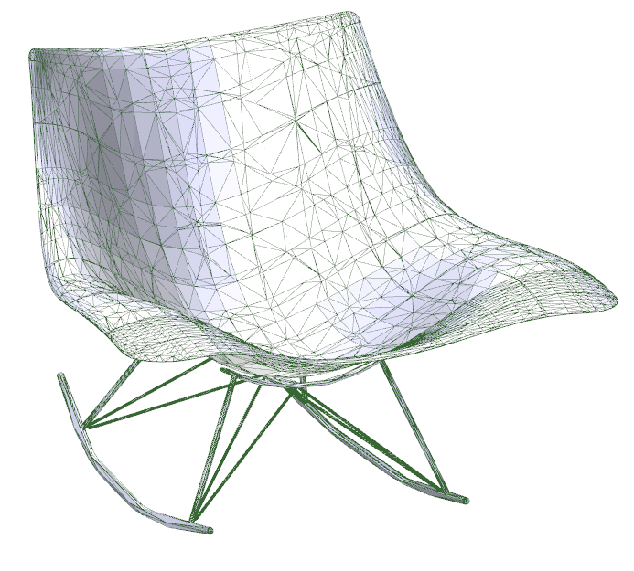
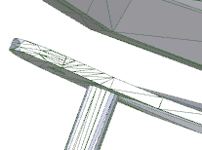
Key Observations
3D models are often designed for viewing.
Parts do not touch!
(not easily noticeable to the viewer, yet geometric implications on topology, connectedness...)
Notes:
Furthermore, artifacts in geometric representations are common. For example, if you zoom in at the polygon mesh of this chair, you’ll see that parts are actually disconnected, and this has implications on topology and connectedness of the shape, which in turn can affect networks that strictly operate on the mesh geometry and connectivity.

Slide 18
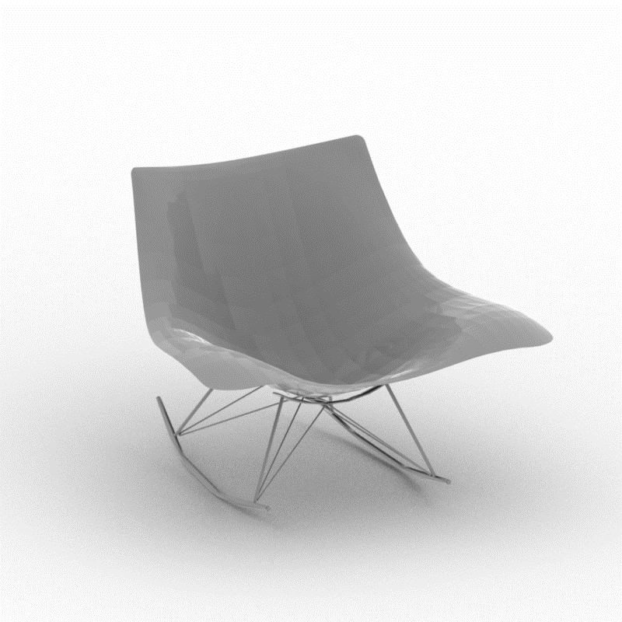
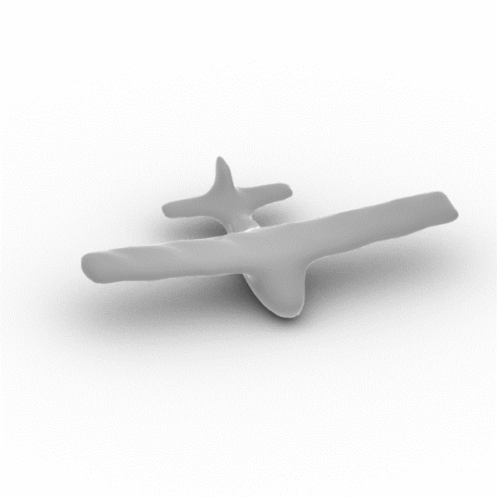
Key Observations
Shape renderings can be treated as photos of objects (without texture)
Shape renderings can be processed by powerful image-based architectures through transfer learning from massive image datasets.
Chair!
Image-based network
Airplane!
(Su et al, ICCV 2015)
(Kalogerakis et al. CVPR 2017)
Notes:
Finally, as shown in earlier work on view-based architectures in the cases of shape classification and segmentation, a key advantage of view-based architectures is that they can re-purpose image-based networks pre-trained on massive image datasets. The pre-trained filters encode already shape information that is useful for transfer learning.

Slide 19
Key Ideas
Deep architecture for processing rendered views of surface neighborhoods around points at multiple scales. View selection to handle self-occlusions.
Notes:
Motivated by all the observations... we designed a view-based deep architecture. Specifically, it processes rendered views of local surface neighborhoods around each point of interest. The captured neighborhoods vary in size so that our network encodes multi-scale context around each point. We also select appropriate views around each point to avoid self-occlusions.

Slide 20
Key Ideas
Deep architecture for processing rendered views of surface neighborhoods around points at multiple scales. View selection to handle self-occlusions.
Trained to embed semantically similar points close to each other in descriptor space.
Notes:
The network is trained such that geometrically and semantically similar points in the training dataset are embedded close to each other in descriptor space.

Slide 21
Key Ideas
Deep architecture for processing rendered views of surface neighborhoods around points at multiple scales. View selection to handle self-occlusions.
Trained to embed semantically similar points close to each other in descriptor space.
Massive, synthetically generated training dataset: 977M corresponding point pairs
Notes:
To train our network, we created a synthetic dataset of 1B corresponding point pairs, which is the largest such repository, by several orders of magnitude,
assembled so far for learning local descriptors.

Slide 22
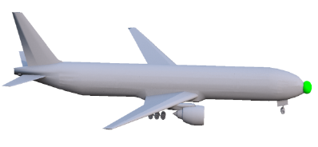
Pipeline
View
selection
LMVCNN
Local shape
descriptor
Notes:
I will now discuss our pipeline that implements these key ideas.

Slide 23
Pipeline
View
selection
LMVCNN
Local shape
descriptor
Notes:
starting with the first stage, which is the point-based view selection

Slide 24
Notes:
So let’s say we want to compute a descriptor for the green point in the front of the airplane you see here.

Slide 25
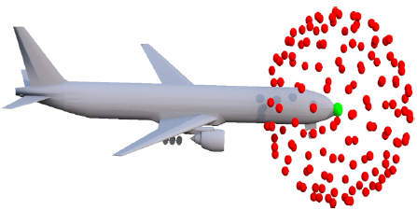
View Selection
Step 1: Uniformly sample directions on the viewing hemisphere of the input point
Notes:
The first step of this stage is to uniformly sample directions on its viewing hemisphere. However,

Slide 26
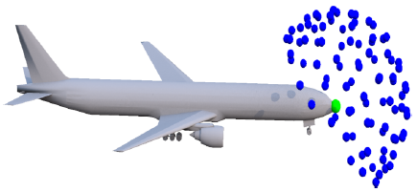
View Selection
Step 1: Uniformly sample directions on the viewing hemisphere of the input point
Step 2: Find directions the point is visible from
Notes:
Not all of them are good. For some of these view directions, the point of interest might be inaccessible, or in other words the point is invisible from some directions. Thus we remove those.

Slide 27


View Selection
Step 1: Uniformly sample directions on the viewing hemisphere of the input point
Step 2: Find directions the point is visible from
Step 3: Prune redundant views through clustering
Notes:
Many viewing directions tend to be redundant, meaning that if we take rendered views of the surface neighborhood from similar directions, the resulting surface renderings will also be very similar. To prune redundant views, and in this manner, save computational time, we perform view clustering to select the most representative ones.

Slide 28
View Selection
Notes:
Now that we selected our view directions, we are ready to place our cameras.

Slide 29
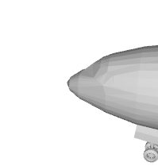

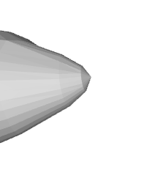
Rendered views
Render shaded images (normal dot view vector).
Point is at the center of the rendered image.
Notes:
and start the rendering. For each viewpoint, we render shaded images simulating Lambertian reflectance. Note that all these renderings are point-specific – the point of interest is at the center of the rendered image.

Slide 30
Rendered views
Perform in-plane camera rotations for rotational invariance.
Notes:
If our input shape is rotated, then the local surface neighborhoods would appear rotated in the rendered images. To promote rotational invariance, we rotate our cameras about their viewing direction.

Slide 31
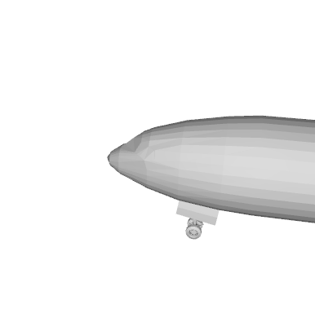
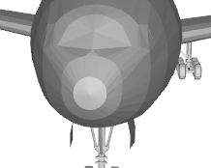
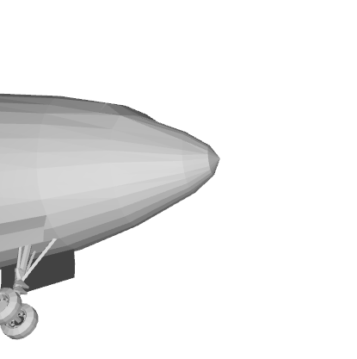
Rendered views
Use progressively zoomed
out views to capture multi-scale context.
Notes:
We also place cameras at increasingly larger distances from the point. The reason is to capture increasingly larger context around it. All these rendered images, including the previous ones are…

Slide 32
Pipeline
View
selection
LMVCNN
Local shape
descriptor
Notes:
passed into our multi-view convnet.

Slide 33
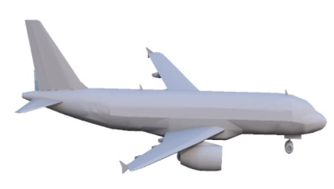
Network Architecture
…
Notes:
Here is how they are processed. Let’s say that we have our input shape, and a point, like the wingtip that you see here. Each rendered view

Slide 34
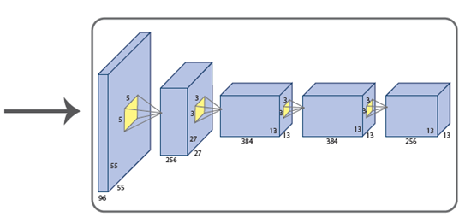
Network Architecture
…
CNN branches (shared parameters)
Notes:
is passed through a convnet, namely AlexNet in our implementation. Since views are unordered, we do not use different filters per branch. All the convnet branches you see here have shared filters.

Slide 35
Network Architecture
…
CNN branches (shared parameters)
View-based representations
Notes:
Each branch outputs a view-dependent representation for the input point, unwrapped into a 4096-dimensional vector.

Slide 36
Network Architecture
36 views
4096-D each
…
CNN branches (shared parameters)
View-based representations
Notes:
We have up to 36 views in our implementation, thus we have maximum 36 such view-based representations for the input point. Obviously, having all these different and unordered high dimensional vectors is not a compact representation.

Slide 37
Network Architecture
36 views
4096-D each
(Su et al, 2015)
(Kalogerakis et al. 2017)
max
…
CNN branches (shared parameters)
View-based representations
Notes:
Thus, we need to aggregate them into a single descriptor. To do so, we make the following remark. Each of these 4096 entries in the output representations tend to encode something about the point e.g., the first entry in these representations may encode how sharp the surface is locally around the point. In each view, sharpness might be evaluated differently. If the network is confident that the surface is sharp in one of the views, thus, the entry will be very high for that view, the max operator will select this entry and ignore others from different, potentially non-informative views.

Slide 38
Network Architecture
36 views
4096-D each
(Su et al, 2015)
(Kalogerakis et al. 2017)
max
…
CNN branches (shared parameters)
View-based representations
Notes:
We use the max-operator for each of the entries across views….

Slide 39
Network Architecture
36 views
4096-D each
(Su et al, 2015)
(Kalogerakis et al. 2017)
max
…
CNN branches (shared parameters)
View-based representations
Notes:
… to compute our descriptor for our point.

Slide 40
Network Architecture
36 views
4096-D each
4096-D
max
…
CNN branches (shared parameters)
View-based representations
Notes:
This aggregated descriptor is still high-dimensional

Slide 41
Network Architecture
36 views
4096-D each
4096-D
128 dim.
max
Dimens.
reduction
…
Final
descriptor
Point
descriptor
CNN branches (shared parameters)
View-based representations
Notes:
We further reduce its dimensionality to 128 to make nearest neighbor queries more efficient and also down-weigh any dimensions that contain no useful information. Dimensionality reduction is performed by adding one more fully connected layer in our network after view pooling.
This concludes the descriptor computation, in other words, a forward pass through our architecture.

Slide 42
Network Architecture
36 views
4096-D each
4096-D
Training?
128 dim.
max
Dimens.
reduction
…
Final
descriptor
Point
descriptor
CNN branches (shared parameters)
View-based representations
Notes:
Obviously now we need to train our architecture! So how do we train it?

Slide 43
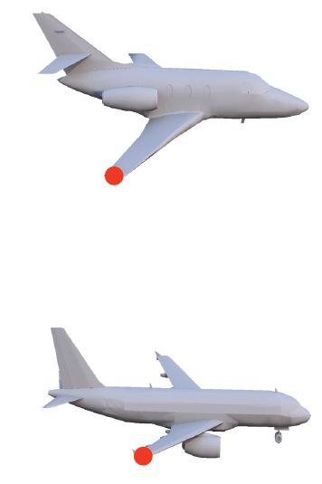
Training
Point pairs from two shapes
Notes:
As you may recall earlier, we want corresponding points across shapes to be embedded close to each other in descriptor space. Thus, to train our architecture, we need pairs of training shapes, and also corresponding points on them, like the wingtips on the two airplanes you see here.

Slide 44
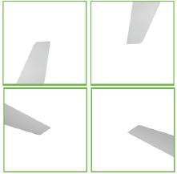
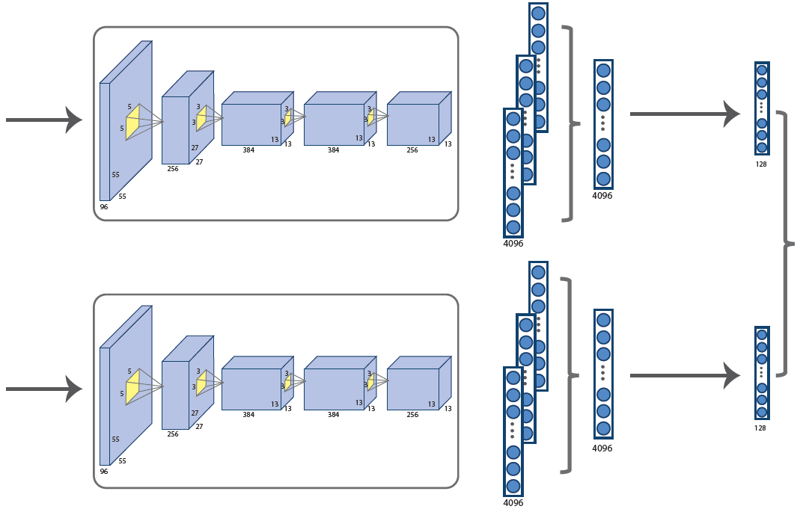
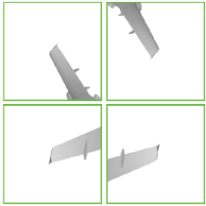
Training
…
…
Point pairs from two shapes
Local rendered
views
“Siamese” LMVCNNs
processing each point
Notes:
During training we process the each point through our convnet to extract their descriptors

Slide 45
Training
…
Loss
function
…
Point pairs from two shapes
Local rendered
views
“Siamese” LMVCNNs
processing each point
Notes:
Then we define a loss function. So remember that we want to push the descriptors of corresponding points to be as similar as possible, thus our loss function

Slide 46
Training
…
Loss
function
…
Point pairs from two shapes
Local rendered
views
“Siamese” LMVCNNs
processing each point
Notes:
penalizes large distances for corresponding points in descriptor space. However, this is not enough. If we try to minimize this loss function, then a trivial solution is to assign the same descriptor to all points – the loss becomes 0 in this case.

Slide 47
Training
Contrastive loss:
(Hadsell et al, 2006)
…
Loss
function
…
Point pairs from two shapes
Local rendered
views
“Siamese” LMVCNNs
processing each point
Notes:
Thus, apart from corresponding points between two shapes, we also need non-corresponding points that we pick randomly. For these dissimilar points, we use another term in our loss function that penalizes small descriptor differences up to a margin.

Slide 48
Training
…
Loss
function
…
Point pairs from two shapes
Local rendered
views
“Siamese” LMVCNNs
processing each point
Initialize filters from their pre-trained values on ImageNet!
Notes:
To initialize our training, we do not start with random values for the convnet filters. We start from filters pre-trained on massive image datasets, which provide a good initialization and helps improving our performance. Then we fine-tune our network on corresponding points of shape pairs…

Slide 49
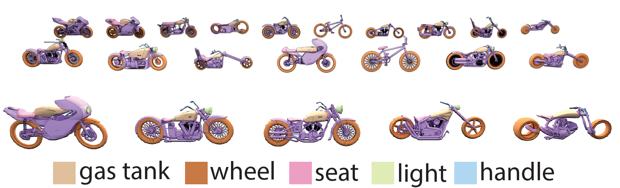
Training Dataset: Part Correspondences
ShapeNetSem: 16 categories, 5K shapes segmented into labeled parts
[Yi et al. 2016]
Notes:
that originate from segmented 3d shapes collections. Specifically, we pick 5K shapes across 16 categories from ShapeNetSem, which contains shapes annotated with part labels, such as the ones you see here, for motorbikes… These shapes only contain labeled parts – there are no corresponding point annotations, and we do want to avoid gathering those manually, because it would be an enormous workload for humans to provide them

Slide 50
Training Dataset
Non-rigid alignment between
parts with the same semantic label
=> pick nearest point pairs
(corresponding points have same color)
Notes:
Instead, we generate corresponding point pairs automatically. For each pair of parts with the same label from two training shapes, we perform non-rigid alignment to deform each part of one shape to the corresponding part of the other shape – after deformation, we find nearest point pairs and set these as corresponding. Note that we avoid performing alignment globally for the two shapes, since this is more likely to fail due to structural differences they may have. Part-based alignment succeeds more often, and even if the point pairs we get are not perfect matches, we found that our network works immensely better compared to training it on tiny, manually annotated datasets.

Slide 51
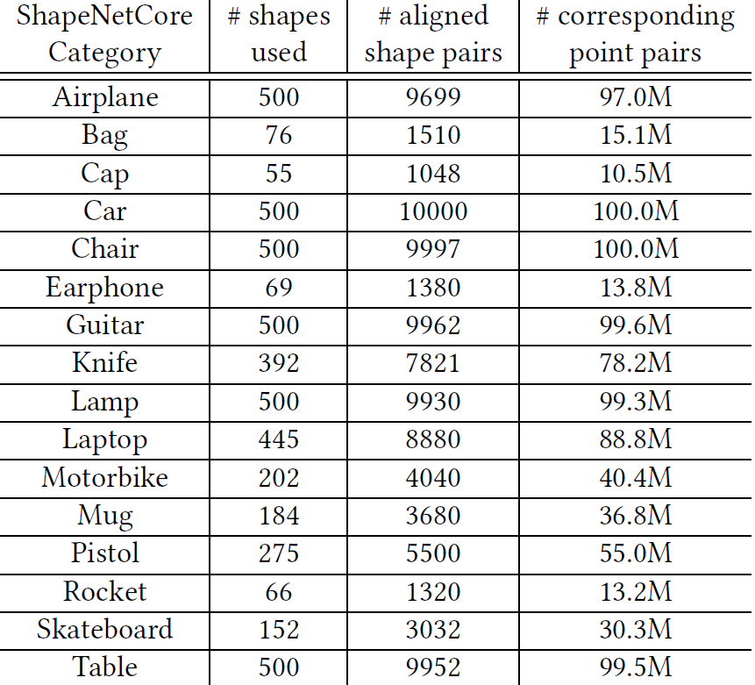
Training Dataset
Non-rigid alignment between
parts with the same semantic label
=> pick nearest point pairs
(corresponding points have same color)
Notes:
In fact, they key to success of our training is that this automatic procedure yields millions of corresponding points, which across our 16 categories,

Slide 52
Training Dataset
Non-rigid alignment between
parts with the same semantic label
=> pick nearest point pairs
977M corresponding point pairs
(corresponding points have same color)
Notes:
amounts to 977M corresponding point pairs.

Slide 53
Evaluation &
Applications
Notes:
So time to evaluate our network and discuss applications.

Slide 54
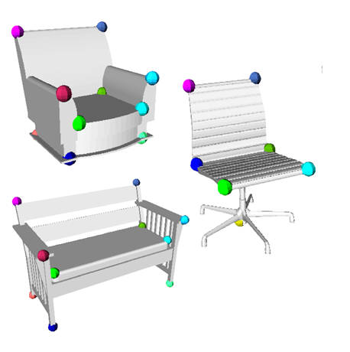
Evaluation
“BHCP” dataset: 4 categories, 404 shapes, annotated with 6-12 corresponding feature points
[Kim et al. 2013]
Notes:
For evaluation, we use the benchmark from Kim et al. 2013, where humans provide ground-truth corresponding points for 404 shapes across 4 categories: bikes, helicopters, chairs, airplanes. The humans annotated 6-12 feature points on each shape on average.

Slide 55
Evaluation
“BHCP” dataset: 4 categories, 404 shapes, annotated with 6-12 corresponding feature points
+ applied a random 3D rotation to each shape
[Kim et al. 2013]
Notes:
We also applied a random 3D rotation to the shapes to check whether the different descriptors included in our experiments are rotationally invariant or not

Slide 56
Evaluation
“BHCP” dataset: 4 categories, 404 shapes, annotated with 6-12 corresponding feature points
+ applied a random 3D rotation to each shape
BHCP shapes not included in our training datasets.
[Kim et al. 2013]
Notes:
Obviously, we do not want the test shapes to exist in our training datasets, thus we performed duplicate checks to ensure this.

Slide 57
Evaluation
“BHCP” dataset: 4 categories, 404 shapes, annotated with 6-12 corresponding feature points
+ applied a random 3D rotation to each shape
BHCP shapes not included in our training datasets.
Three conditions:
Train on one ShapeNet class / test on corresponding BHCP class
[Kim et al. 2013]
Notes:
We performed evaluation under 3 conditions. In the first condition, we trained our network and alternatives on one ShapeNet class, e.g., chairs, and test on the corresponding BHCP class, chairs again. In this condition, the descriptors we get are category-specific.

Slide 58
Evaluation
“BHCP” dataset: 4 categories, 404 shapes, annotated with 6-12 corresponding feature points
+ applied a random 3D rotation to each shape
BHCP shapes not included in our training datasets.
Three conditions:
Train on one ShapeNet class / test on corresponding BHCP class
Train on all ShapeNet classes / test on BHCP
[Kim et al. 2013]
Notes:
We also evaluated our method when trained in a cross-category setting. In this setting, we train our network on training correspondences across all 16 categories of the segmented ShapeNet, then test on BHCP. Note that the BHCP has 3 out of 4 categories (bikes, chairs, airplanes) that also exist in ShapeNet

Slide 59
Evaluation
“BHCP” dataset: 4 categories, 404 shapes, annotated with 6-12 corresponding feature points
+ applied a random 3D rotation to each shape
BHCP shapes not included in our training datasets.
Three conditions:
Train on one ShapeNet class / test on corresponding BHCP class
Train on all ShapeNet classes / test on BHCP
Train on ShapeNet classes different from BHCP
[Kim et al. 2013]
Notes:
So we incorporate a third, even more challenging scenario. We remove the training point pairs originating from the ShapeNet bikes, chairs, airplanes, and test on BHCP. In this condition, the test shapes belong to entirely different classes from the ones used in training.

Slide 60
1. Train on one ShapeNet class / test on corresponding BHCP class
100
100
Airplanes
Bikes
%correspondences
%correspondences
50
50
LMVCNN yields an average +10% improvement in correspondence accuracy
0
0
0.25
0.25
Euclidean distance
Euclidean distance
100
100
Chairs
Helicopters
%correspondences
%correspondences
50
50
0
0
0.25
0.25
Euclidean distance
Euclidean distance
LMVCNN
3DMatch
PCA
SI
SC
SDF
Notes:
Let’s see what happens when we evaluate in the first condition. Here I show the correspondence accuracy plots for our method, shown with orange curves, for airplanes, bikes, chairs, and helicopters. As you may note, compared to other methods, including previous hand-engineered methods, and volumetric networks shown with purple curves, our method yields much higher correspondence accuracy,
[The y-axis of the plot demonstrates the fraction of correspondences predicted correctly below a given Euclidean distance threshold shown on the x-axis.]

Slide 61
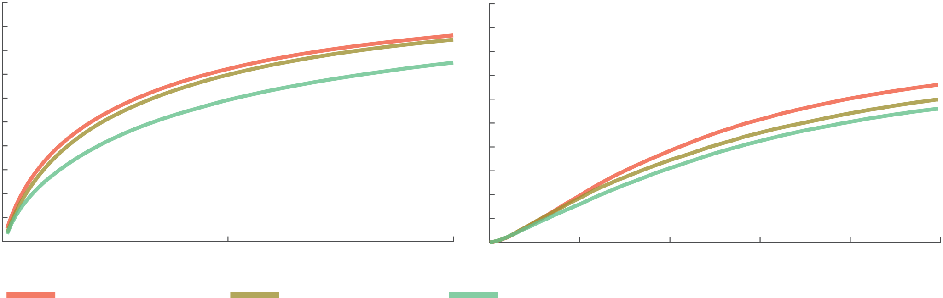
2. Train on all ShapeNet classes / test on BHCP
100
Cumulative Match Characteristic
(averaged over BHCP)
Correspondence accuracy
(averaged over BHCP)
%hit rate
%correspondences
50
0
50
100
0.25
number of matches
Euclidean distance
LMVCNN
category-specific
LMVCNN
cross-category
SC
Notes:
Let’s move to the second condition, where we train our method in a cross-category manner in an effort to build a more generic descriptor. Here we show the Cumulative Match Charateristic plot - the higher the curve is, the better. The orange curve is our method trained in a category-specific manner. The green curve is the best alternative method, which was the shape contexts. The curve that you see in-between is our network trained in a cross-category manner. The performance is a bit below the category-specific training variation.
[– the y-axis shows the fraction of ground-truth corresponding points whose rank in the retrieval is equal or below the rank marked on the X-axis. ]

Slide 62
2. Train on all ShapeNet classes / test on BHCP
100
Cumulative Match Characteristic
(averaged over BHCP)
Correspondence accuracy
(averaged over BHCP)
%hit rate
%correspondences
50
0
50
100
0.25
number of matches
Euclidean distance
LMVCNN
category-specific
LMVCNN
cross-category
SC
Notes:
We observed a similar trend in the correspondence accuracy plots. Our generic, cross-category descriptors, although a bit worse than our category-specific descriptors, are still pretty good, better than alternatives.

Slide 63
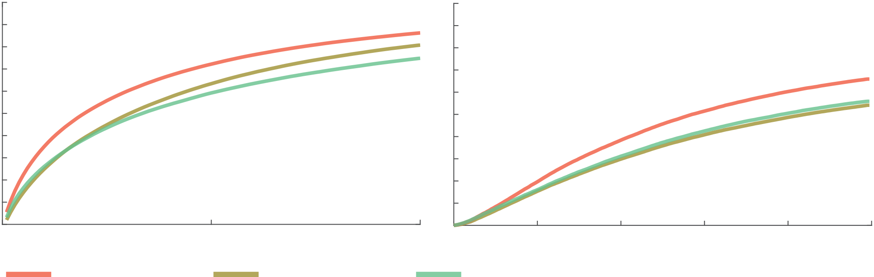
3. Train on ShapeNet classes different from BHCP
100
Cumulative Match Characteristic
(averaged over BHCP)
Correspondence accuracy
(averaged over BHCP)
%hit rate
%correspondences
50
0
50
100
0.25
number of matches
Euclidean distance
LMVCNN
category-specific
LMVCNN
cross-category
excl. BHCP classes
SC
Notes:
And here is the most stretched scenario, where we remove bikes, airplanes, and chairs from our training datasets, and we entirely test on shapes whose class was not observed during training. The performance degrades, yet it is seems to be on par, or maybe a bit better, at least in terms of CMC performance, than the best alternative.

Slide 64
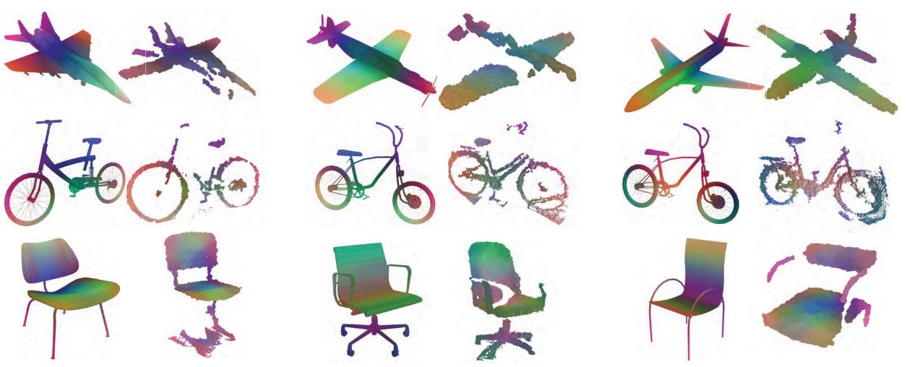
Applications: partial scan-to-shape matching
Trained on ShapeNet models => test on scans
(similar colors correspond to points with similar descriptors)
Note: point clouds are rendered using a sphere per point
Notes:
Our feature descriptor can also be used in various applications, as I mentioned here. Here I show some qualitative results that demonstrate correspondences between scans you see in the second column versus 3D models of complete shapes retrieved from a shape database in the first column. Even with noise and missing data, our descriptors can still yield good matches - again, I remind you that same color means matched points. See for example, the wings on the airplanes have similar colors, or the backs of the chair

Slide 65
Applications: partial scan-to-shape matching
Trained on ShapeNet models => test on scans
(similar colors correspond to points with similar descriptors)
Note: point clouds are rendered using a sphere per point
Notes:
Here are more results – the third column has complete shapes, the fourth column contains partial scans of similar objects.

Slide 66
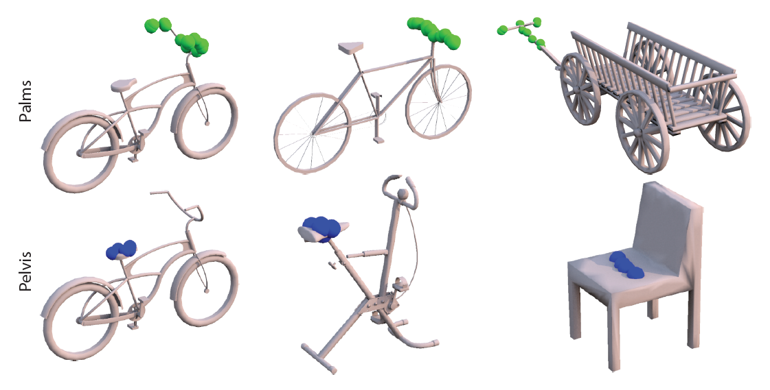
Applications: predicting affordance regions
Fine-tuned on [Kim et al. ’14]’s contact point dataset
Palms
Pelvis
Notes:
We also applied our descriptors for predicting affordance regions on 3D shapes. Our method correctly detects points and regions belonging to similar affordance regions on shapes with considerable structural and functional differences.

Slide 67
Summary
Point-based descriptor learning based on a convnet operating on multi-scale local surface view projections
Notes:
To summarize, I discussed a method for point-based descriptor learning based on a convnet operating on multi-scale local surface view projections

Slide 68
Summary
Point-based descriptor learning based on a convnet operating on multi-scale local surface view projections
Leverage two massive large sources of data to train our network (Imagenet & correspondences we generated from segmented ShapeNet)
Notes:
We leverage two extremely large sources of data to train our network. First, we repurposed architectures pre-trained on massive image datasets. Second, we automatically generated a synthetic dense point correspondence dataset by part-based non-rigid alignment in a large collection of 3D models.

Slide 69
Summary
Point-based descriptor learning based on a convnet operating on multi-scale local surface view projections
Leverage two massive large sources of data to train our network (Imagenet & correspondences we generated from segmented ShapeNet)
Can generalize to scans & classes not seen during training
Notes:
According to our experiments, our method can still generalize to scans and classes not observed during training with relatively good performance

Slide 70
Limitations
Surface information can be lost in projections
Notes:
Multi-view CNNs have their advantages, such as re-use of filters trained on massive image datasets, but also disadvantages, such as missing surface information due to the projections

Slide 71
Limitations
Surface information can be lost in projections
Redundancy in processing (same surface is visible from multiple views)
Notes:
There is also some redundancy in processing – nearby points will have similar views, large portions of viewed surface will be common for nearby points.

Slide 72
Limitations
Surface information can be lost in projections
Redundancy in processing (same surface is visible from multiple views)
Max view pooling might cause some information loss
Notes:
Max pooling might also not be the most ideal way to aggregate view descriptors – it might still cause some information loss

Slide 73
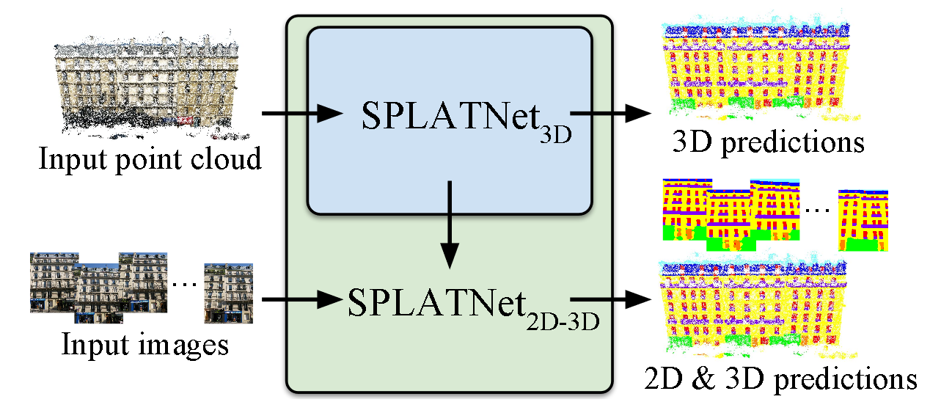
Limitations
Surface information can be lost in projections
Redundancy in processing (same surface is visible from multiple views)
Max view pooling might cause some information loss
Combine view-based with 3D-based nets, see SplatNet, Su et al., CVPR ‘18
Notes:
More than a year passed since this work is accepted, and obviously things are moving rapidly. There are many newer deep networks appeared in the literature. For example, SplatNet is a recent architecture that combines the best of both 2D and 3D worlds. SplatNet operates on 3D point set representations of shapes, and can also takes into account RGB images or surface renderings as additional input to improve 3D shape analysis, inspired by multi-view networks. I encourage you to check these more recent works.

Slide 74


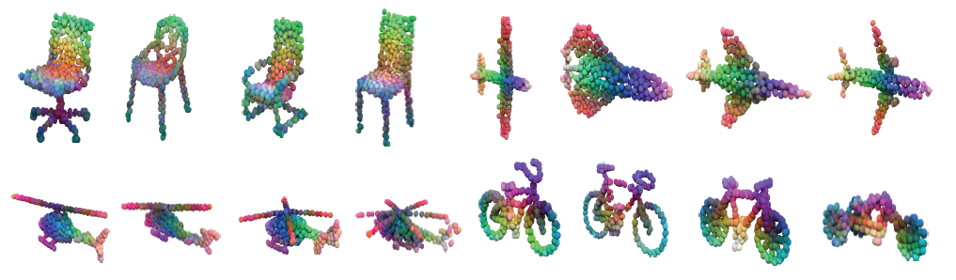
Thank you!
Our project webpage with source code & dataset:
http://people.cs.umass.edu/~hbhuang/local_mvcnn/
Notes:
Thank you for your attention. We show here our project page that includes more details.

